Slide 1

Bringing the Enterprise into the Open Source World
How we did it…
Daniel Ruggeri, Principal Engineer

Slide 2
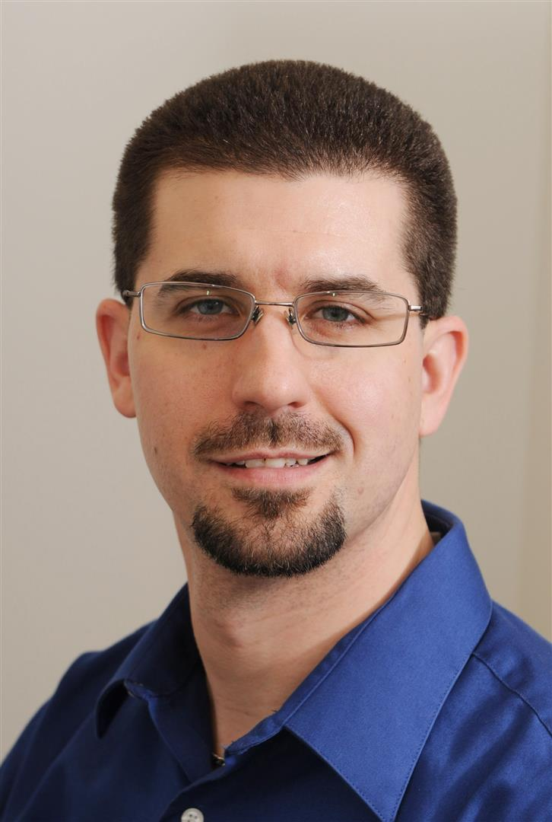
An Introduction
Work:
Principal Engineer
Design and implement on/off-prem clouds
Grew up in Internet space
Open Source advocate
Founding member of our OSS program
We’ll talk all about this
Play:
Apache Software Foundation
VP Fundraising, member, httpd PMC
Adjunct instructor
Open Source Software Development (University of MO – St. Louis)
Software Development (Washington University)
Daniel Ruggeri
DRuggeri <at> apache.org

Slide 3
Some History

Slide 4

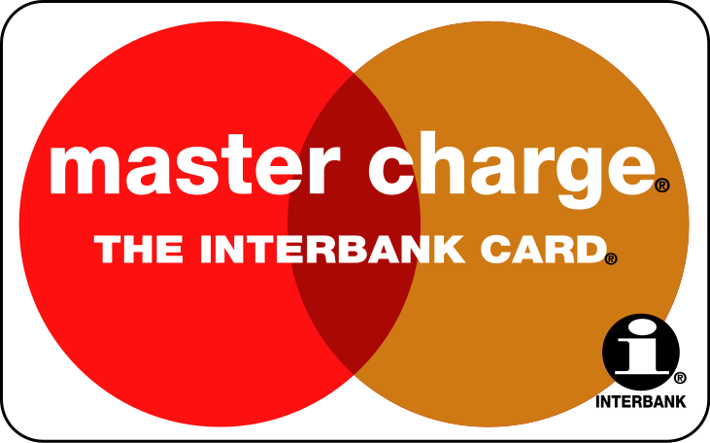
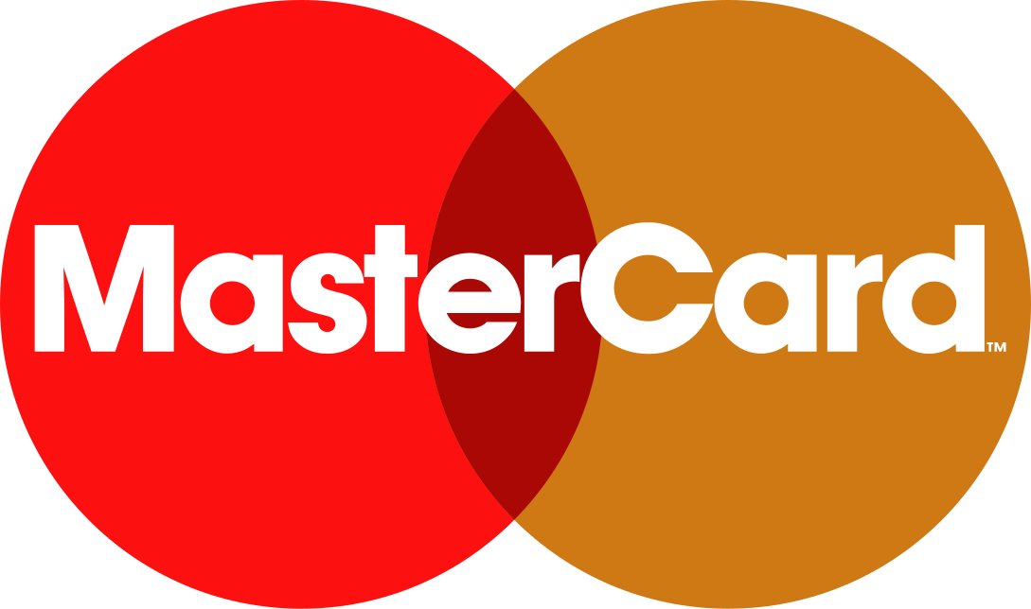



We’ve been around a while
1966
1969
1979
1990
1997
2016
Founded by member banks as a cooperative
Organic growth
Public company on NYSE (MA) in 2006
Notes:
Founded by member banks as a cooperative
Born from process-oriented industry
Highly rigorous, military-level discipline
Organic growth
Even from US to EU through partnerships
Key focus was all about the banks and “wiring the world”
Public company on NYSE (MA)
“We are a tech company in the finance industry” became our mantra circa 2010

Slide 5






Related OSS history
1978
1983
1989
1994*
1998
2000
OSS was being born in the 70’s
X window and its business focus
Foundations helped change the game
All logos copyright by their respective organization
Notes:
Born in the 70’s Became a MOVEMENT in the late 70’s to early 80’s
Xwindow’s business focus – nice, but…
FSF dominated the conversation as a God-given right. Kept OSS “niche”
Foundations and other movements
OSI helped change the rhetoric and focused on the business value
Foundations helped create vendor-neutral environments

Slide 6
“Real enterprises do not
use open source software.”
“We <3 Open Source!”

Slide 7
How We Did It

Slide 8


Become the Champion(s)
Prepare for the long haul
You own responsibility
Do you <3 OSS enough?
Know your stuff
Licenses, intellectual property, legal, copyright, etc
Company processes
Identify barriers and define success
Get ready for the barriers
Be prepared to track progress
Pro tip: There can be more than one champion
Notes:
A champion…
Has integrity
Is willing to step up
Has perseverance
Is an evangelist
This will probably be a long journey
YOU can make or break this effort
… just be ready to own the responsibility
The most important part: KNOW YOUR STUFF COLD
Be well versed in all the links included in this presentation
Be a master of internal processes
Legal review
How developers work
Who to reach out to
There can be more than one champion
Leverage the drive of others, too. We had two driving champions for our program.

Slide 9

Form a Team of Stakeholders
Establish the bootstrap team
You may need to educate team members
“You have two ears and one mouth”
The team should be experts of their domain
Our bootstrap team:
Development & Operations
Information Security
Legal
Intellectual Property
Pro tip: Get an Executive sponsor
Notes:
Establish the “bootstrap team”
Approach as: “We WILL be contributing to OSS. What do we need to know?
Who HAS to be involved from the beginning?
If you would feel foolish for responding `no` to the question of “Did XYZ review this?”, they should be on the team.
You have two ears and one mouth…
because you should listen twice as much as you talk
Although you are the champion, they are the experts at their field
This team will make or break the success of the program
Our bootstrap team, by chance of how we went about it
You may need others such as….
Enterprise Architecture
Internal Audit/Compliance
Tools Support
Having an executive sponsor can help lend weight to the program

Slide 10

Articulate WHY
You must be able to answer, “Why are we doing this?”
There IS a benefit to your company, so explain it
This is not everyone’s day job, so be patient
Some starting points
“We don’t want to maintain patches and custom builds”
“Do well by doing good”
“Give our company a seat at the global table”
“This drives technologists to us and enhances our careers”
“It’s FREE!”
The whole team should be able to do this
Pro tip: Check your corporate objectives. I bet they can help!
Notes:
Be able to answer why
Your company is unlikely to be opposed to against OSS – just apathetic because of the many competing priorities
Remember that you are on an education campaign
These starting points worked for us
Maintaining custom patches and builds is awful. Let’s just push that upstream.
By contributing back to the industry, we are giving back to the world. This is a donation/philanthropy.
Being consumers only forces you to react to what the community gives you. This allows us to help steer the direction
We are always looking for top talent and we care greatly about the talent we have. Technologists WANT to do this
Forming a community around a project we run gives diverse perspectives!
Everyone on the team should be able to articulate this to the “uninitiated”
This helps remind you of how important your team is
Nearly every company has philanthropic objectives and ways to participate in the industry

Slide 11

Establish The Process™
Figure out how to collaborate
How will the core team work?
This is OSS, so be transparent
Define how people engage and work
Balance stakeholder and contributor needs
Be concerned about Internal ←→ External, too
Education and understanding is a top goal
VERY IMPORTANT in most enterprises
There must be a process
Be thorough in putting this together
Pro tip: Make the process as easy as possible
Notes:
Ways to collaborate:
“Innersourcing” – running the program like an OSS project
Keeping visible internal pages of info (wiki, website, project site, etc)
Do you have the right tooling?
How people engage and work: The hard part
Your customer is the team you’re helping open up a project
How will your customers work with you?
How will the public community work with your customers?
A note about education:
Your customers need to know that they are representing your company
Do they know what is safe and unsafe to publish?
Do they understand why we are open sourcing stuff?
… would they be a good evangelist to have?
The importance of process in the enterprise…
This was vital for us
Ensures certain tasks are performed and certain folks are accountable
Let’s ignore CLA for this slide

Slide 12

Pick a LICENSE.txt
This saves big headaches
Suggest a license so people have a starting point
Choose a well-known license
This is important
LICENSE establishes copyright and legal use of the code
To CLA or not to CLA
CLA = Contributor License Agreement
We chose Apache License v2
Pro tip: Start with one of the top five
Notes:
Choosing a well-known license…
Avoids potentially costly legal reviews (for consumers/contributors)
Shows you have common sense (avoid reinventing the wheel)
Importance of LICENSE
Copyright is *very important*
It says how you can use/share the software
Owning copyright allows you to change the license later
Remember this… if you don’t own all the copyright…
Do you want a CLA?
Explicitly assigns copyright and acknowledges the contributor is allowed to contribute this code
Potential paperwork involved – is legal ready for that?
Apache License 2
Permissive (business friendly)
Includes patent grant (protects us and contributors)
Assigns license for contributions to be Apache License 2 by default

Slide 13

Document and Socialize
Documentation (everyone’s favorite part)
Important for scale
Minimal docs:
What is Open Source
Why are we doing this?
The Process™
Who to talk to for help
Good doco helps sell the program
Accidental communities may form
Pro tip: Take the show on the road and involve your exec. sponsor
Notes:
Documentation
I never said it was all going to be fun
Pointing people to the documentation helps get them going
Minimal docs
Don’t assume the enterprise understands what OSS is to the level you do
Remember the WHY question? Answer it thoroughly here
The process should be in the forefront so people know how to get up and going
Be sure to tell them where they can go for guidance
This is a sales point!
People who have gone through the process can point others to it
When bumps happen on the journey, rely on your doco and principles

Slide 14

Keep it Going
Assumption:
You successfully bootstrapped the program
Enter maintenance mode
Grow the program
Check in with stakeholders and exec. sponsor
Track and report
Look at the core team again
We chose to add several evangelists at this point
Helps spread the load and shows the program is here to stay
Pro tip: Find some evangelists
Notes:
Good job, you did it!
As you built the program, you identified the necessary things to bootstrap
Continue those things – ensure you are tracking and reporting important bits
Are all of your stakeholders happy? Does your executive sponsor have the info they need?
It may be time to review the core team and adjust the composition

Slide 15
Potential Gotchas

Slide 16
The License Will Be Questioned
Probably not a big deal
Experience: “Why X instead of Y?”
Articulate your reasons for choosing the license
Be flexible since no license is a perfect fit all the time
Brace the team for this, too
Do be worried about copyright
Side note: It’s hard to lose copyright
Defense: Know your stuff
Pro tip: Involve your team for their input
Notes:
If this comes up, the best thing to do is to have a clear reason why the license was chosen
Do be concerned with copyright
Copyright allows a venue for defending your project
Copyright ownership allows you to change the OSS license type
Good read: the CC0 rationale: https://creativecommons.org/share-your-work/public-domain/cc0/

Slide 17
Errors Will Be Made
Prepare an action plan for these scenarios:
Stuff that probably shouldn’t be public made it out there
We committed something *sensitive*
We committed something *private*
When it happens, handle it promptly
You and the core team are accountable
Defense: judicious use of delegation
You can only own so much
Expect common sense from your customers
Pro tip: Remember that distributed version control has history!
Notes:
Humans make mistakes
At some point, someone will do something that isn’t the best
How will you respond to scenarios?
Most important point: Be available for the discoverer
Sometimes this is audit, security, legal, etc
Our approach
The program owns the process and light oversight
The developers own the repo
There is a named individual for each repo that bears accountability

Slide 18
“Who is THAT?”
There may be non-company addresses in SCM history
Community contributions
This is normal
We permit personal accounts in our repos
This is unique
We keep an inside → outside the firewall translation
Self service
Pro tip: Maintain an audit trail

Slide 19
Business vs Personal
As the program grows/grew, were your assumptions right?
Identity specifically
Inside the firewall vs outside
Be concerned with protections
You as a company
Your people as users/contributors
The projects as consumers
Pro tip: Remember the labor laws!

Slide 20
Wrap it Up

Slide 21
Handy links and notes
People who do this for a living: https://todogroup.org
License compatibility matrices: https://en.wikipedia.org/wiki/License_compatibility
Some good notes about choosing a license: https://opensource.guide/legal/
Trademarks and OSS? Yes, please! http://fossmarks.org/
Apache Software Foundation resolved legal questions https://www.apache.org/legal/resolved.html
Dept of Defense FAQ on OSS* https://dodcio.defense.gov/Open-Source-Software-FAQ/
Teach a class on this stuff https://github.com/druggeri/OSSClass
THIS presentation: https://people.apache.org/~druggeri/presentations/
Notes:
* Some advice is a bit out of touch

